Slide 1
Week-04 Developing Applications with WebML
Course Instructors:
Haris Ahmed
DEPARTMENT OF SOFTWARE ENGINEERING
SIR SYED UNIVERSITY OF ENGINEERING & TECHNOLOGY

Slide 2
agenda
What is WebML?
WebML Models.
Preview of WebML concepts
WebML Operations
Siteviews
WebML Development Process
Summary

Slide 3
Why WebML?
WebML purpose
WebML stands for Web Modeling Language. It is a conceptual language used for designing web applications.
It tells us how the website’s structure, data, and navigation will be organized.
WebML aims at providing a structured approach to the design of Data-intensive Web sites
A set of integrated Models should help designers in high-quality Web sites production
Notes:
WebML: a conceptual language for high-level design of data-intensive web sites
Models: Structure, derivation, composition, navigation, presentation
To create high-quality websites To cover everything (data, design, navigation)

Slide 4
Target of WebML
Target: data intensive Web sites
– large amount of data
– interfaces directed to general public
– volatile content, structure, navigation, presentation
WebML is not the right approach for:
– Small Web sites (Homepages, …)
– Static Web sites

Slide 5
The WebML models
WebML: a conceptual language for high-level design of data-intensive web sites
Models:
– Structure: data organization
– Derivation: redundant data definition
– Composition: definition of site pages as set of subpages and elementary publishing units
– Navigation: definition of links between pages and between units
– Presentation: positioning of the units in the page and definition of graphical appearance
Notes:
Data redundancy: when same data exists in multiple places
Data inconsistency: when same data exists in diff formats in multiple places.

Slide 6
1. Structure Model
Q: what are the objects published in the site and how they are related? 1.
Which objects will be published on the website, and what is the relationship between them?
Here we decide what kind of data will exist in the system.
In a freelancing site:
Users (Freelancers + Clients)
Jobs (Projects posted by clients)

Slide 7
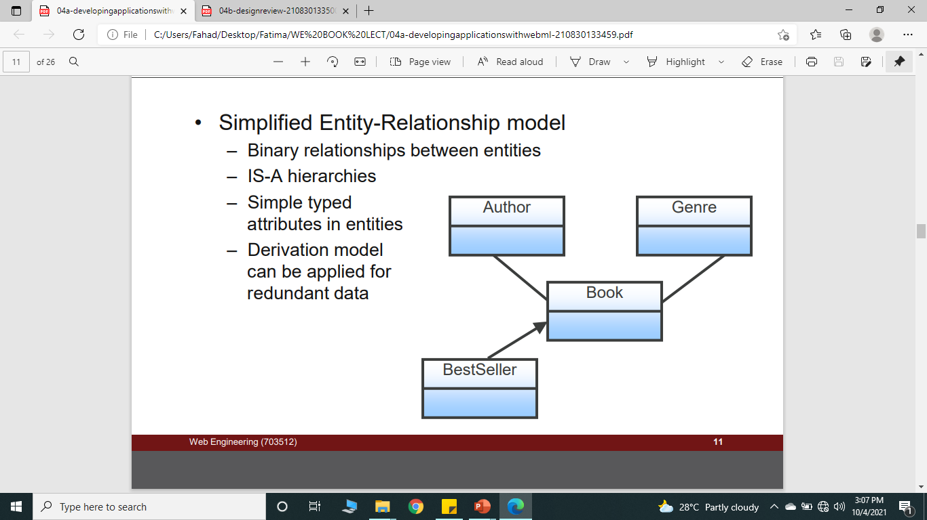
CONTD…
Simplified Entity-Relationship model
– Binary relationships between entities A direct connection between two entities.
– IS-A hierarchies
– Simple typed attributes in entities This shows that one entity is a type of another entity.(p.c)
– Derivation model can be applied for redundant data

Slide 8
II. Derivation Model
In this model, we generate new data from existing data.
Example:
Total number of jobs
Completed projects of a user
Top freelancers list
Derivation consist of writing expressions called “derivation queries”
Queries can be expressed using WebML OCL
Derivable concepts:
Entities, relationships, attributes
Derivation queries can be automatically transformed into SQL views installed in the database
Notes:
OCL-object constraint language

Slide 9
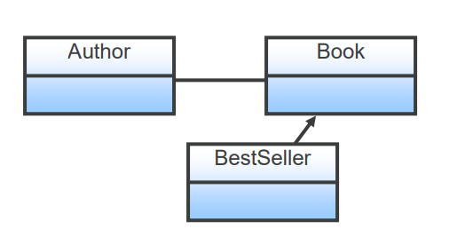
Derivation Model CONTD…
Redundant data can be easily specified using a WebML-OQL (Object Query Language).
E.g.:
– Author.BooksNumber = count(self.Author2Book)
– BestSeller := Book where Book.Sales > 50,000

Slide 10
11i Composition Model
Here we decide how the website pages will be structured and what they will display.
Home Page
Job Listing Page
Job Detail Page
Apply Page

Slide 11
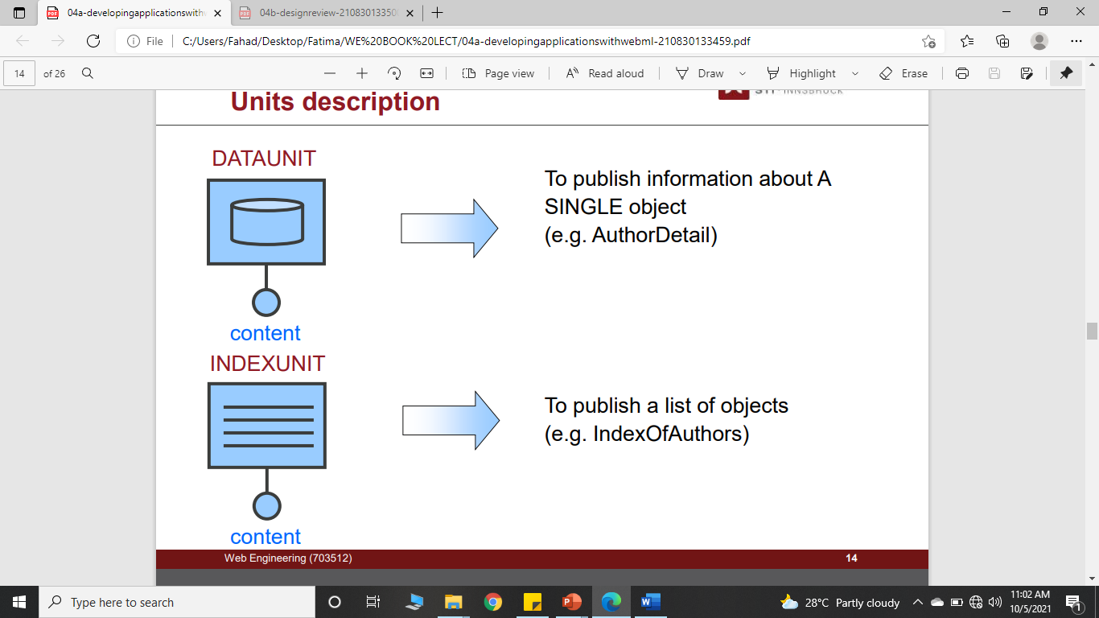
III. Composition Model: Basic Content Units
Notes:
Single information like form
And no next type information

Slide 12
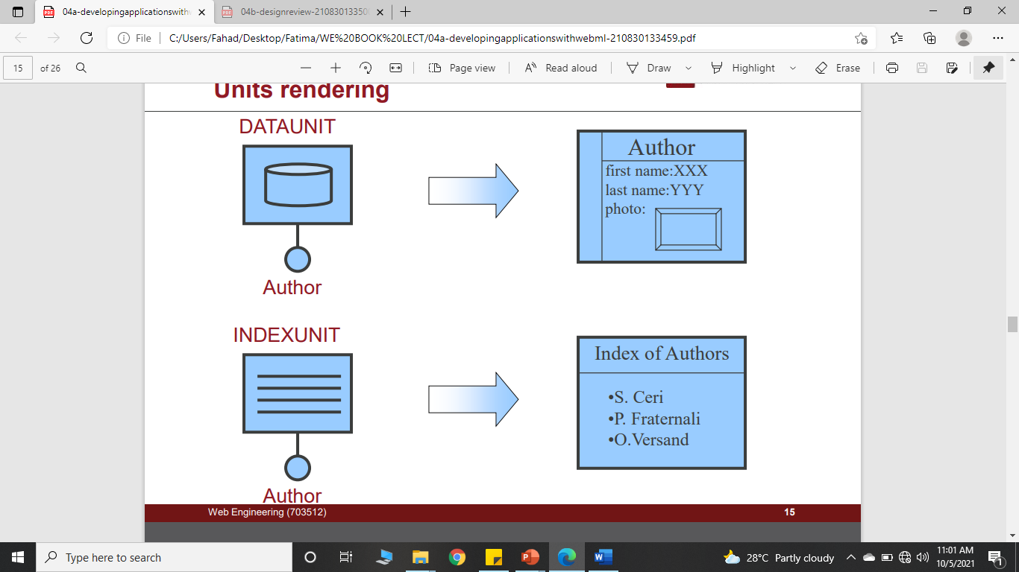
Composition: meaning of Content Units

Slide 13
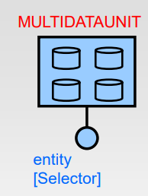
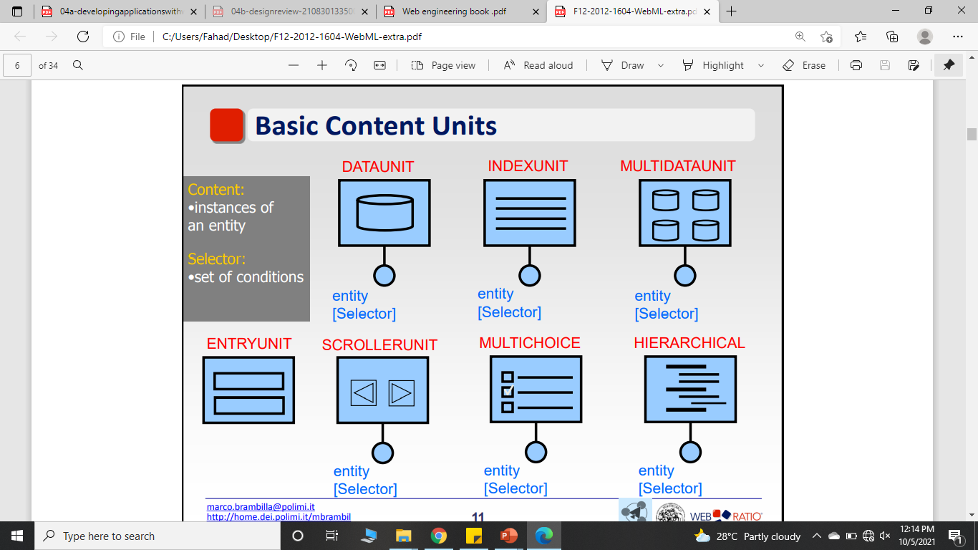
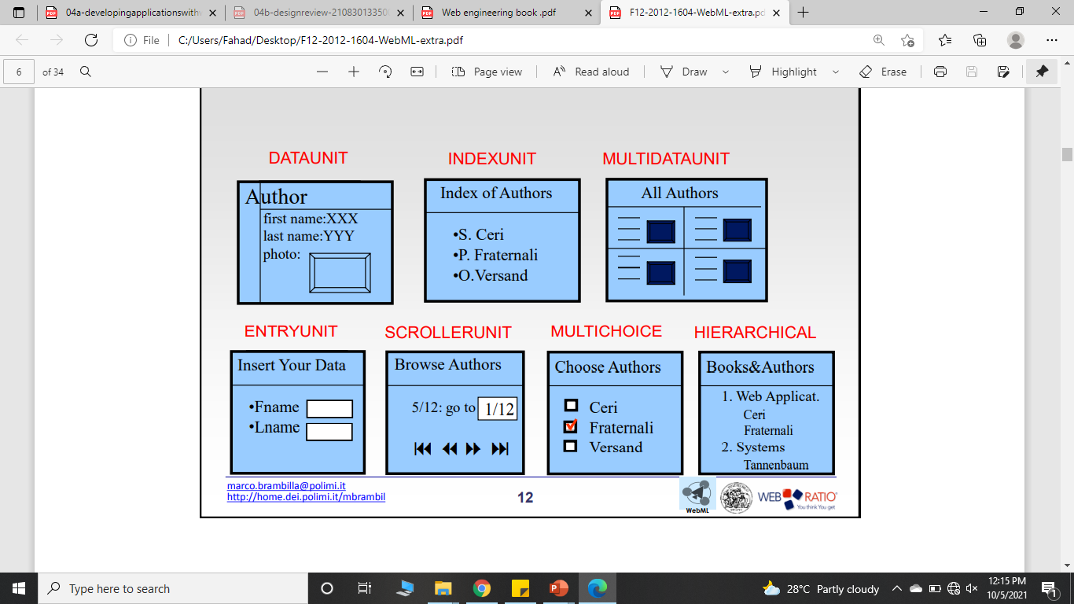

Contd…

Slide 14
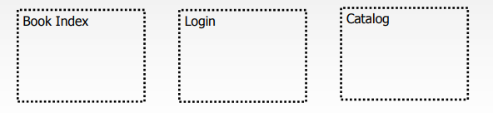
Composition: Pages
A page is a container of one or more pieces of information shown to the user at the same time
Nesting of pages is allowed: a page can have sub-pages
The user navigates a site made of pages

Slide 15
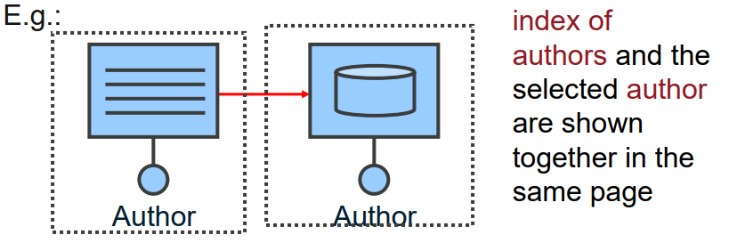
Composition: Pages
A Page is a structured container of units and links
– Possibly structured in and/or sub-pages
– Abstraction of screen, frame…
– Permits one to cluster related information for more efficient communication
Notes:
Deatl page and specfici opne detail page

Slide 16
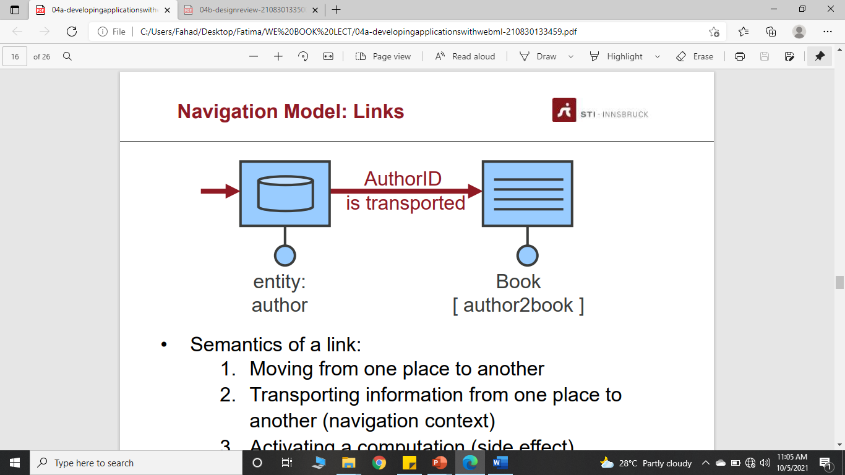
iv. Navigation Model: Links
Semantics of a link:
Moving from one place to another
Transporting information from one place to another (navigation context)

Slide 17
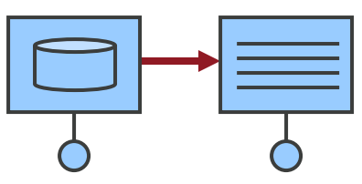
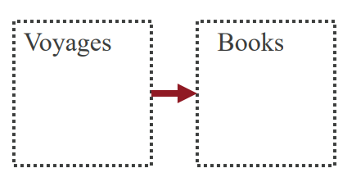
Types of links
Contextual links
– Between units
– Context transported
Non-Contextual links
– Between pages
– No context transported
Notes:
Same information open in next tab
No information pass

Slide 18
Siteviews
Mobile version
Desktop version
A Siteview is a set of pages that the user can experience as a whole Web site
Different site views can be defined for different devices and different groups of users
Thus, access control and multi-devices delivery is achieved

Slide 19
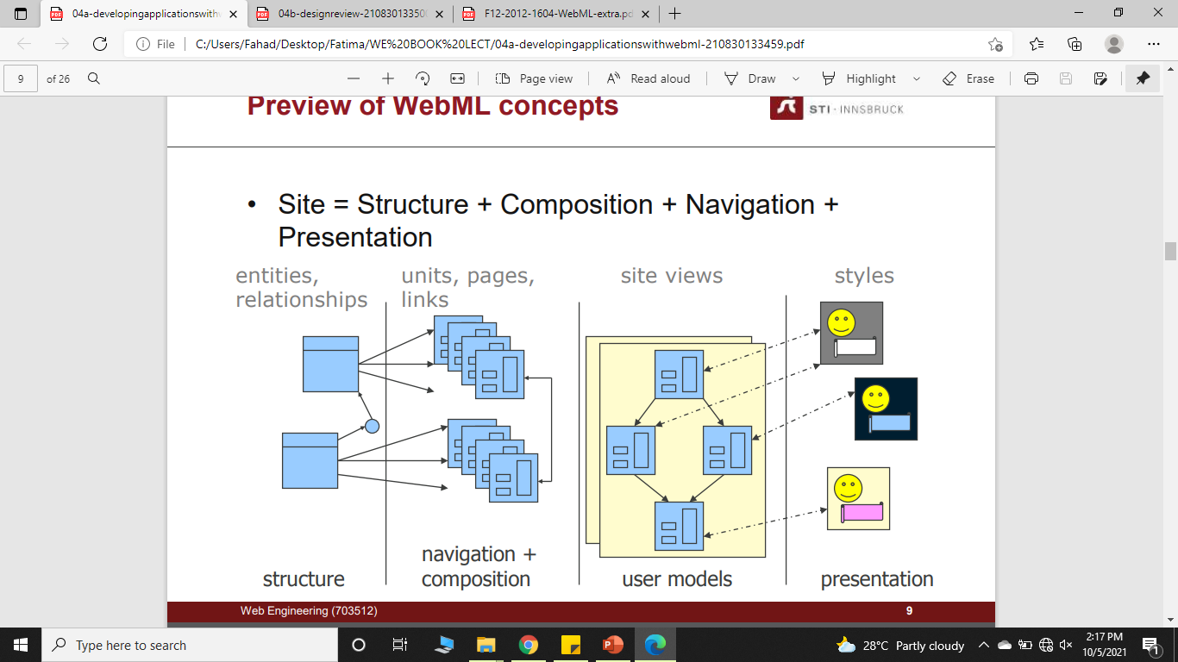
Preview of WebML concepts

Slide 20
WebML operations: Built-in Operations
WebML predefines a set of frequently used built-in operations to manage a site’s content.
They are the traditional database operations: create, delete, modify, create relationship, delete relationship.
Users do not need to define the behavior and the implementation; they are provided off-the-shelf in the model.

Slide 21
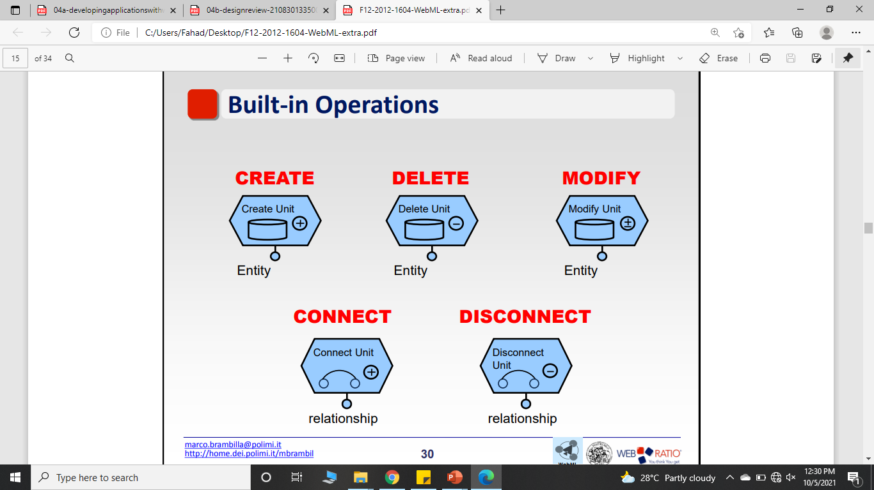
Built-in Operations
Notes:
User ↔ Job “connect”
Jo application cancel

Slide 22
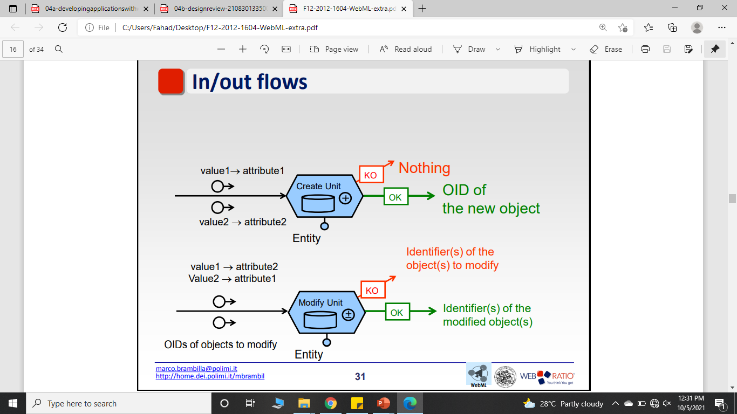
In/out flows: Create, modify unit
OK link if the operation completes correctly
KO link if the operation fails

Slide 23
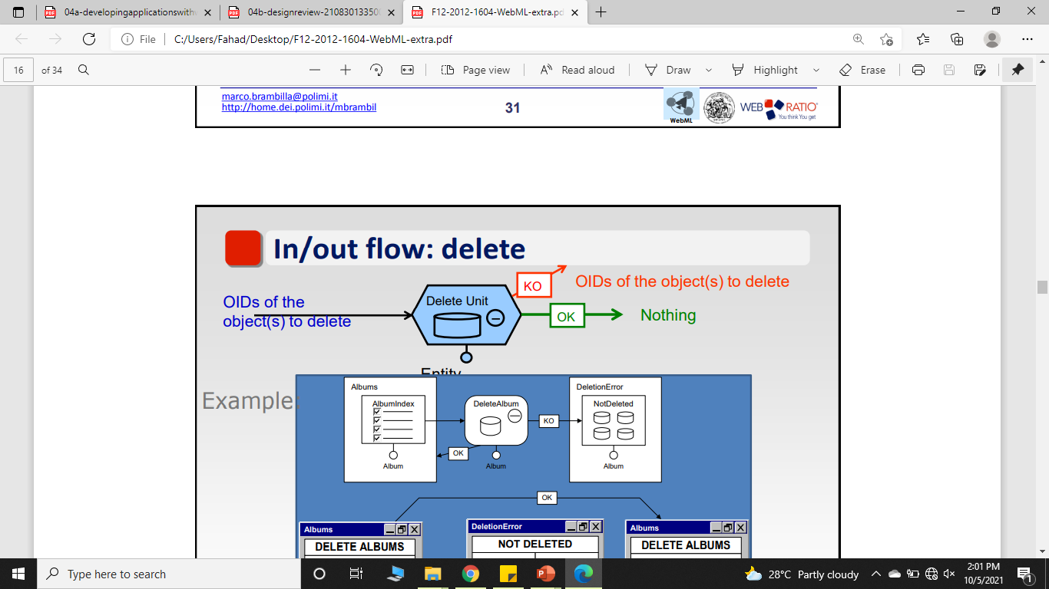
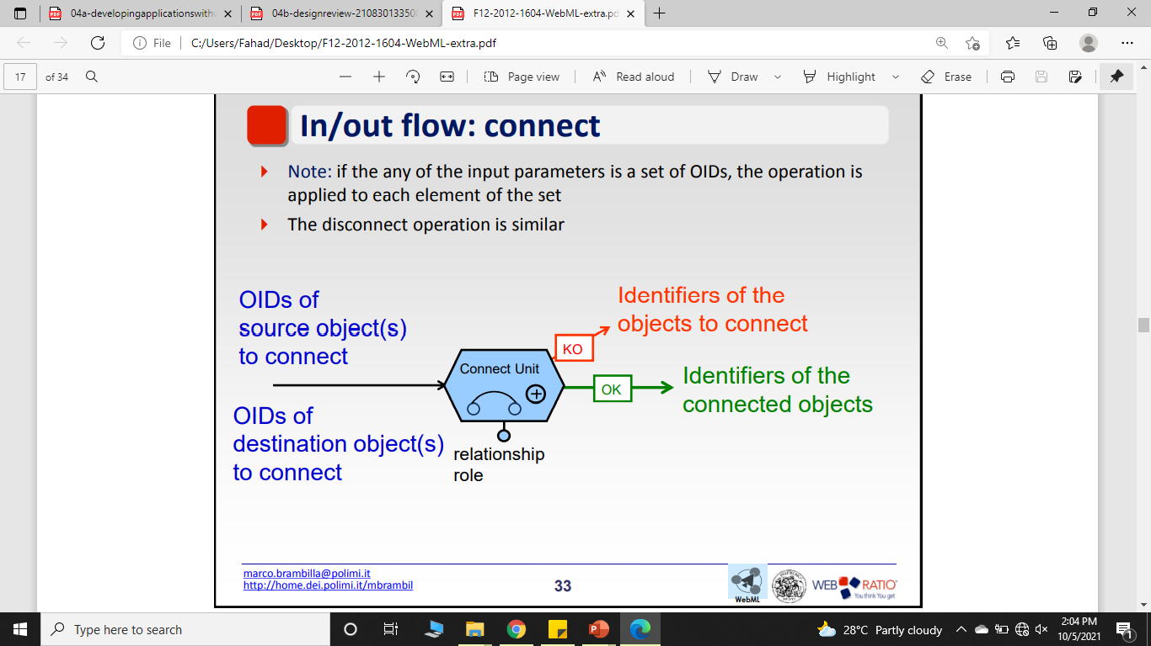
In/out flows: Delete, connect unit

Slide 24
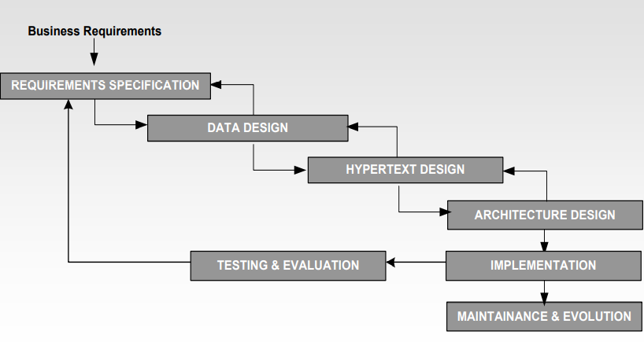
WebML Development process
Notes:
Purpose
Functional requirements and non
Data type
Navigatuon design
Arcticure design ;language

Slide 25
summary
WebML is Domain Specific Language (DSL)
WebML is about Model Driven Design and Development
– Focus on data intensive Web applications
– Automatic code generation of Web applications

Slide 26
BIBLIOGRAPHY
Web Modeling Language (WebML): a modeling language for designing Web sites
https://www.ra.ethz.ch/cdstore/www9/177/177.html

Slide 27
Class Activity- Simple Address Book
The purpose of this system is to express the extraction of object content from the domain objects and the selection of the attributes to be published. The user shall access one page, which publishes a list of objects. For each object a set of attributes values are displayed.
In this case the example is an address book of contacts. Each contact will contain a name, two phone numbers (main and alternative), two postal addresses (main and alternative), and one e-mail address.
Design considerations and requirements
The system will offer a page with an introductory text, and the list of contacts in the agenda, which is stored in a database. For each object the set of its non-empty attributes values will be displayed.

Slide 28
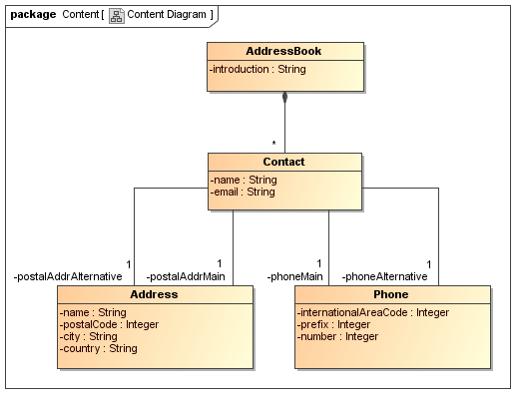
UWE content model of the running example

Slide 29
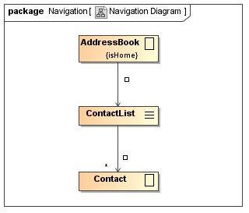
UWE navigation structure of a simple Address Book

Slide 30
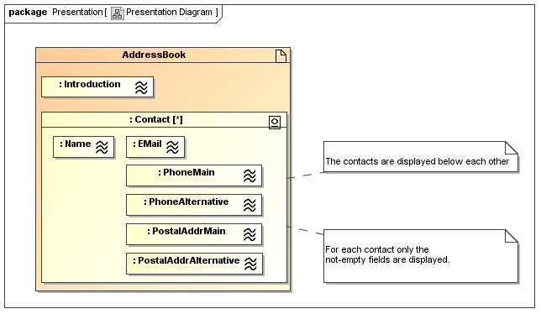
UWE presentation model of a simple Address Book

